Slide 1
Cybersecurity Framework 2.0 and the Migration to Post-Quantum Cryptography Project
Bill Newhouse –NCCoE Cybersecurity Engineer
william.newhouse@nist.gov
March 11, 2025

Slide 2

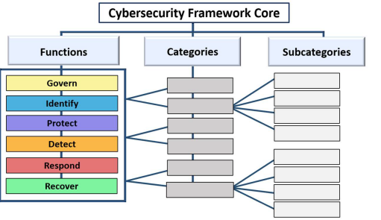
Cybersecurity Framework (CSF) 2.0
Implementation Examples
Informative References

Slide 3
Data centric Crypto risk management approach
Governance
Standards
Regulations
Mandates
Technology
Supply Chains
Threats
1
Business Requirements
Partner Ecosystem
Local Policies
(Modernization)
People (roles/responsibilities)
Processes
2
Data (Assets)
3
Management Tools
4
Risk Management
Code
Information Repository
5
Data
Libraries
Mitigation
Crypto
Risk Analysis Prioritization Engine
Applications
Vulnerability
Files
Migration
Assets
Monitoring
Dashboards
Reports
Measurements/Metrics
Protocols
Log
Systems
Zero Trust
…
…
Crypto-Agility

